Slide 1

Deepfake Detection
Anuraag Vasal

Slide 2
What are Deepfakes
Deepfakes are a media of a person in which their face or body has been digitally altered so that they appear to be someone else, typically used maliciously or to spread false information.
Uses advanced artificial intelligence techniques to manipulate or generate media and can be used to manipulate public opinion around the world.

Slide 3
The Problem with Deepfakes
Deepfake technology can lead to privacy issues, generating fake news and spreading misleading information.
It can easily be used to diverse public opinion and can pose serious threats.
It’s easy to generate due to wide variety of applications and many open-source projects.

Slide 4
Technologies used to Generate Deepfakes
Autoencoders : It is made of a pair of two connected neural networks. The encoder finds and learns similarities between the two images and reduces them to their shared common features, compressing the images in the process. A second AI algorithm called a decoder is then taught to recover the faces from the compressed images.
GAN (Generative adversarial network): Is another deep learning technique to generate deep fake. It is made up of 2 parts a generator that learns to generate plausible data and a discriminator that learns to distinguish the generators fake data from real data

Slide 5
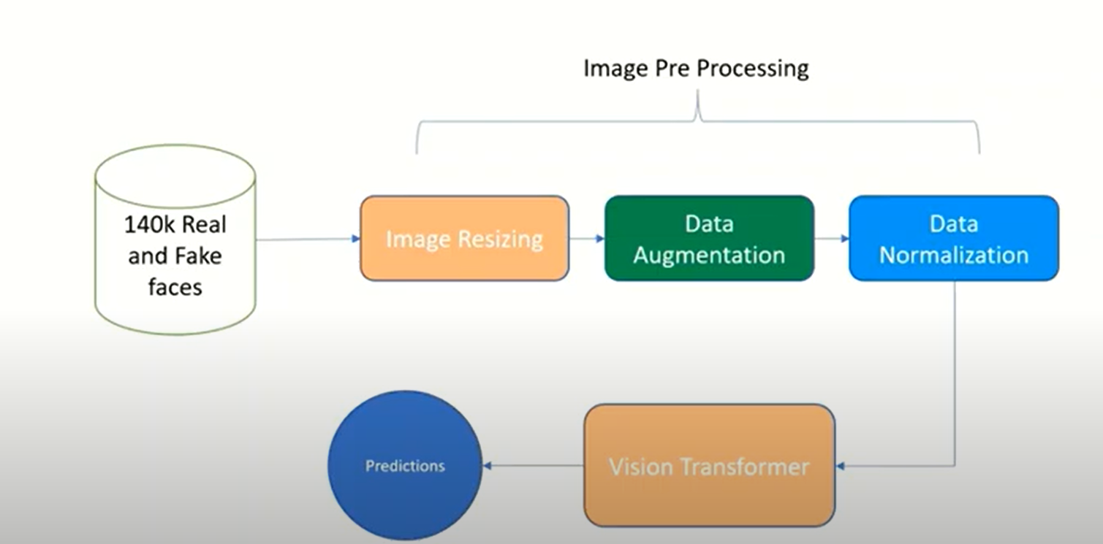
Proposed Solution
Transformer architecture – Vision Transformer
A pretrained Convolution Neural Network
DATA

Slide 6
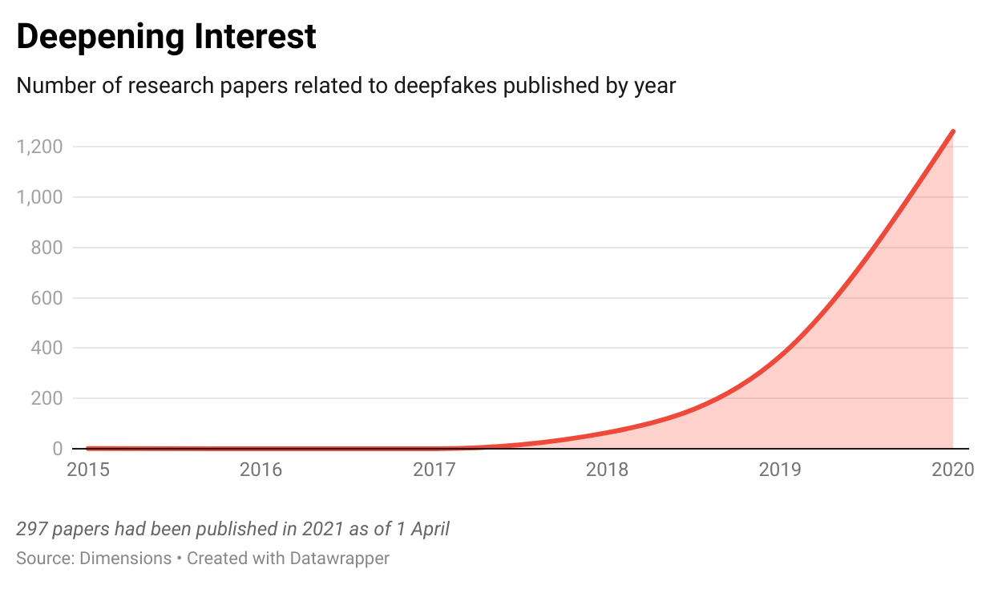
Conclusion
The number of deepfake videos online has been increasing at an estimated annual rate of about 900% which can be a problem later on to identify the real or fake media.
It is important to have a system to detect deepfake media as it can help to stop fake news, misinformation and can help prevent cyber bullying, harassment, etc.

Slide 7
References
https://www.kaggle.com/datasets/xhlulu/140k-real-and-fake-faces
https://www.businessinsider.com/guides/tech/what-is-deepfake
https://www.weforum.org/agenda/2021/04/are-we-at-a-tipping-point-on-the-use-of-deepfakes/

